Slide 1
PRA Group Assignment
Group - 5

Slide 2
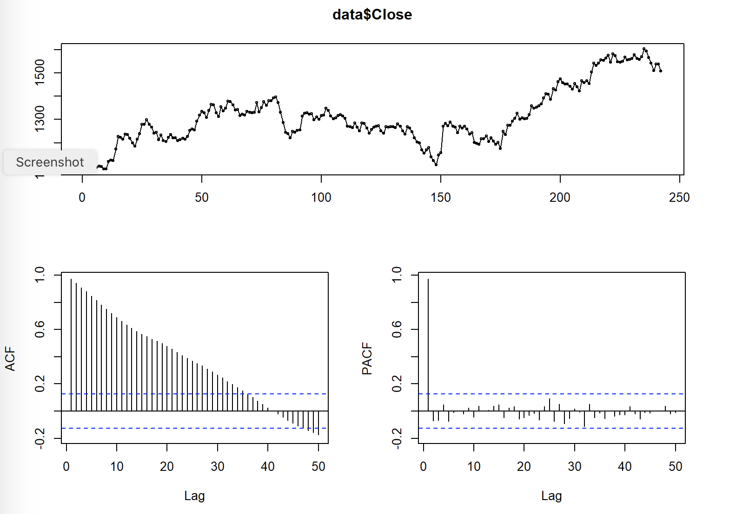
CORRELOGRAM OF TREND SERIES
-> tsdisplay(data$Close, lag=50)
ACF plot indicates that the autocorrelation starts at a very high and is not decaying fast which means the series is non stationary. Hence, we will go for first differencing

Slide 3
ADF TEST FOR TREND SERIES
adf.test(data$Close, alternative="stationary", k=6
OUTPUT
## ## Augmented Dickey-Fuller Test ## ## data: data$Close ## Dickey-Fuller = -1.8752, Lag order = 6, p-value = 0.6283 ## alternative hypothesis: stationary
adf.test(data$Close, alternative="stationary", k=10)
OUTPUT
## Augmented Dickey-Fuller Test ## ## data: data$Close ## Dickey-Fuller = -1.7948, Lag order = 10, p-value = 0.6622 ## alternative hypothesis: stationary
->
The p-value of the ADF test is greater than 0.05 which is statistically proving that the data is non stationary
->

Slide 4
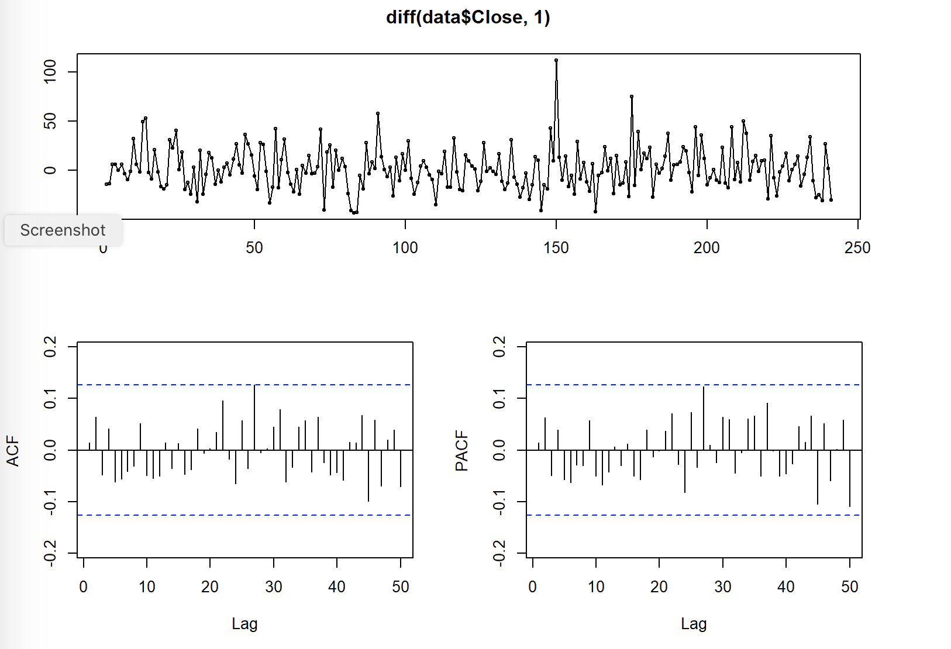
CORRELOGRAM OF TREND DIFFERENCING
-> tsdisplay(diff(data$Close,1), lag=50)
It can be seen that there is no autocorrelation (all the lags are within the confidence intervals)
after trend differencing.

Slide 5
ADF TEST FOR TREND DIFFERENCING
->
adf.test(diff(data$Close,1), alternative="stationary", k=6)
OUTPUT
## Warning in adf.test(diff(data$Close, 1), alternative = "stationary", k = 6): p- ## value smaller than printed p-value
## ## Augmented Dickey-Fuller Test ## ## data: diff(data$Close, 1) ## Dickey-Fuller = -6.1775, Lag order = 6, p-value = 0.01 ## alternative hypothesis: stationary
The ADF test of trend differencing shows that it is stationary as we have reduced the acuteness of the autocorrelation from the component.

Slide 6
ADF TEST FOR SEASONALING DIFFERENCING
-> adf.test(diff(data$Close,5), alternative="stationary", k=6)
OUTPUT
## Warning in adf.test(diff(data$Close, 5), alternative = "stationary", k = 6): p- ## value smaller than printed p-value
## ## Augmented Dickey-Fuller Test ## ## data: diff(data$Close, 5) ## Dickey-Fuller = -4.4309, Lag order = 6, p-value = 0.01 ## alternative hypothesis: stationary
The p-value of the ADF test for seasonal differencing is less than 0.05 which means it also stationary

Slide 7
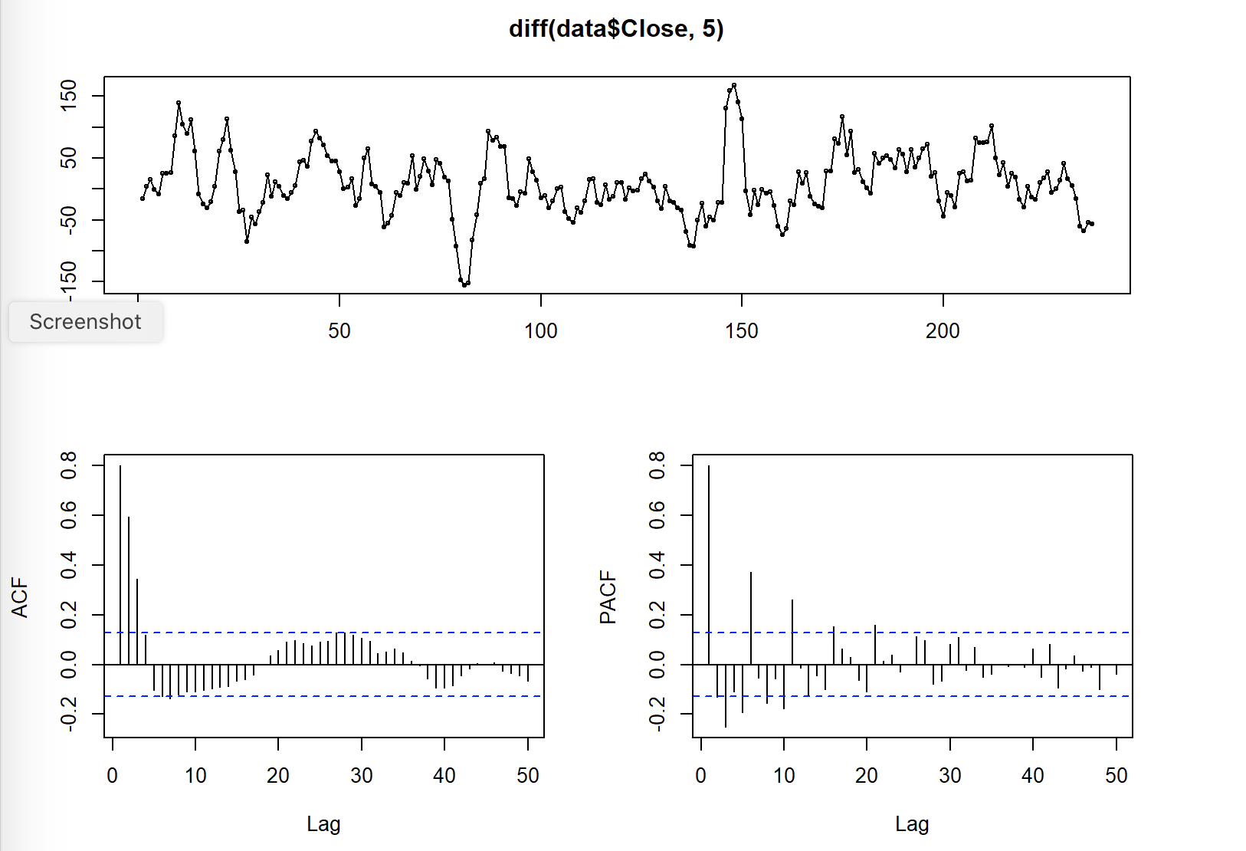
CORRELOGRAM OF SEASONAL DIFFERENCING
-> tsdisplay(diff(data$Close,5), lag=50)
The ACF plot is showing a seasonal pattern
The PACF plot shows which lags are significant

Slide 8
ESTIMATION MODEL 1
fit1 <- Arima(data$Close, order=c(0,1,0), seasonal = list(order = c(1, 1, 1), period=5))
OUTPUT
summary(fit1)
## Series: data$Close ## ARIMA(0,1,0)(1,1,1)[5] ## ## Coefficients: ## sar1 sma1 ## -0.0486 -1.0000 ## s.e. 0.0661 0.0491 ## ## sigma^2 estimated as 482.2: log likelihood=-1072.83 ## AIC=2151.65 AICc=2151.75 BIC=2162.04 ## ## Training set error measures: ## ME RMSE MAE MPE MAPE MASE ## Training set -0.4279307 21.59265 16.63204 -0.04420371 1.272485 1.009312 ## ACF1 ## Training set 0.01653202
b1<-tsdiag(fit1)
Both the coefficients of this arima model are not significant so we cannot consider it for forecasting the prices

Slide 9
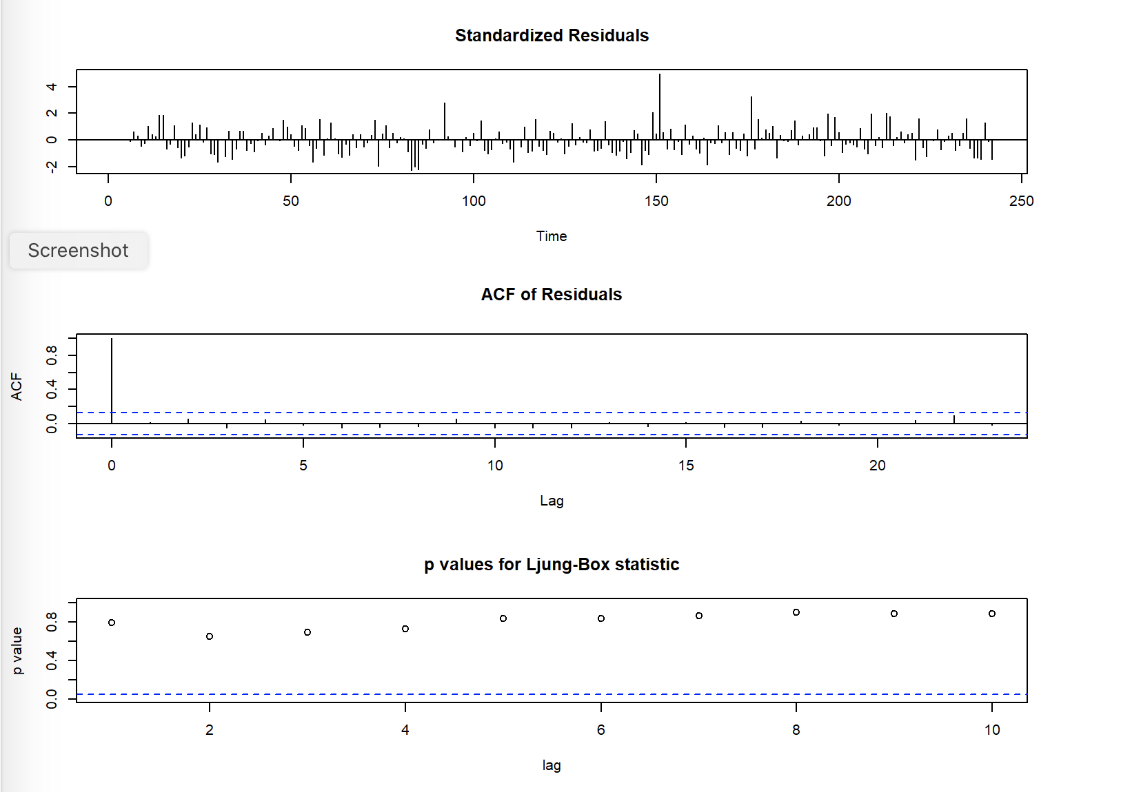
RESIDUAL PLOT OF MODEL 1
Even though all the p-values are greater than 0.05 but we cannot consider this model as none of the coefficients were statistically significant

Slide 10
ESTIMATION MODEL 2
fit2 <- Arima(data$Close, order=c(0,1,0), seasonal = list(order = c(1, 1, 0), period=5))
OUTPUT
summary(fit2)
## Series: data$Close ## ARIMA(0,1,0)(1,1,0)[5] ## ## Coefficients: ## sar1 ## -0.5025 ## s.e. 0.0556 ## ## sigma^2 estimated as 750.9: log likelihood=-1116.4 ## AIC=2236.79 AICc=2236.85 BIC=2243.72 ## ## Training set error measures: ## ME RMSE MAE MPE MAPE MASE ## Training set -0.155783 27.00287 20.60717 -0.008611521 1.575441 1.250542 ## ACF1 ## Training set 0.01485322
b2<-tsdiag(fit2)
Though the coefficient of this model is significant but the AIC is high so we will try to make further improvements with other models

Slide 11
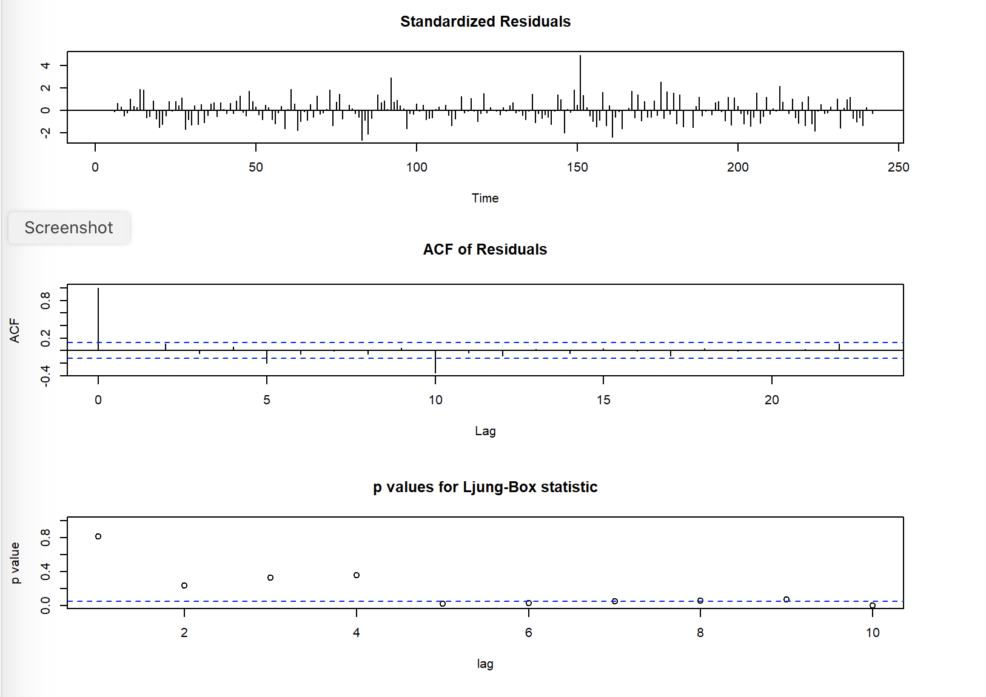
RESIDUAL PLOT OF MODEL 2
The
residual
plot shows
that most
of the
p-values
are less
than 0.05
thereby
indicating
that
residuals
are having
autocorrelation

Slide 12
ESTIMATION MODEL 3
fit3 <- Arima(data$Close, order=c(0,1,0), seasonal = list(order = c(3, 1, 0), period=5))
OUTPUT
summary(fit3)
## Series: data$Close ## ARIMA(0,1,0)(3,1,0)[5] ## ## Coefficients: ## sar1 sar2 sar3 ## -0.7934 -0.5593 -0.2619 ## s.e. 0.0628 0.0730 0.0636 ## ## sigma^2 estimated as 601.4: log likelihood=-1090.5 ## AIC=2188.99 AICc=2189.16 BIC=2202.85 ## ## Training set error measures: ## ME RMSE MAE MPE MAPE MASE ## Training set -0.2682577 24.06253 18.82244 -0.02010608 1.436976 1.142236 ## ACF1 ## Training set 0.02276727
Though the coefficient of this model is significant but the AIC is high so we will try to make further improvements with other models

Slide 13
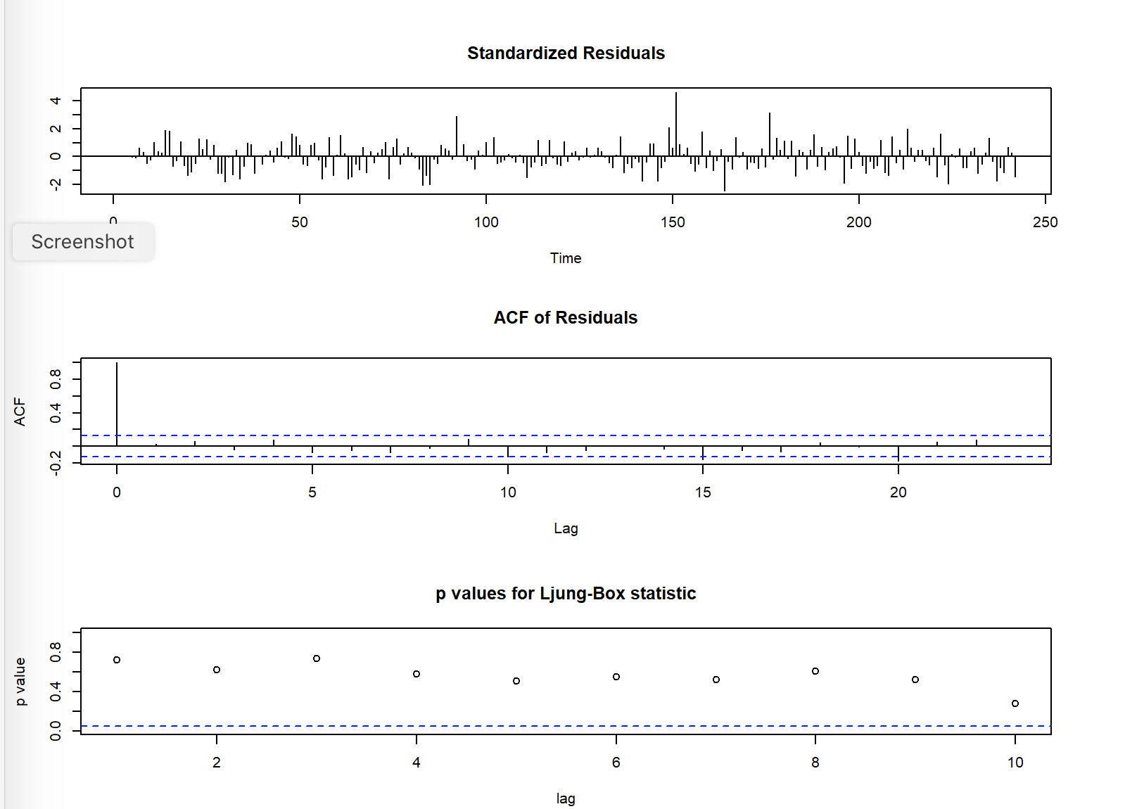
RESIDUAL PLOT OF MODEL 3
-> b3<-tsdiag(fit3)
Almost all the p-values are greater than 0.05

Slide 14
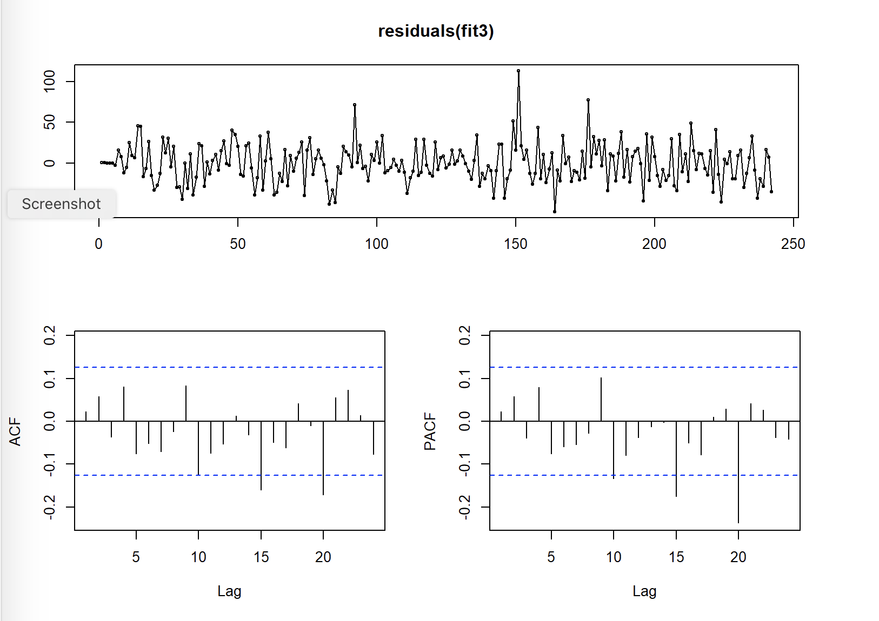
CORRELOGRAM OF RESIDUALS
-> tsdisplay(residuals(fit3))
Since not all the p-values were greater than 0.05 we saw from the tsdisplay that some of the lags in the pacf were still significant thereby indicating that our model was still not able to capture certain predictable information

Slide 15
BOX LJUNG TEST
Box.test(residuals(fit3), lag=50, fitdf=5, type="Ljung")
OUTPUT
## Box-Ljung test ## ## data: residuals(fit3) ## X-squared = 64.121, df = 45, p-value = 0.03193
The box test confirms the presence of autocorrelation in the residual

Slide 16
ESTIMATION MODEL 4
fit4 <- Arima(data$Close, order=c(0,1,0), seasonal = list(order = c(4, 1, 0), period=5))
OUTPUT
summary(fit4)
## Series: data$Close ## ARIMA(0,1,0)(4,1,0)[5] ## ## Coefficients: ## sar1 sar2 sar3 sar4 ## -0.8680 -0.7131 -0.4728 -0.2595 ## s.e. 0.0634 0.0805 0.0804 0.0644 ## ## sigma^2 estimated as 562.1: log likelihood=-1082.75 ## AIC=2175.49 AICc=2175.75 BIC=2192.81 ## ## Training set error measures: ## ME RMSE MAE MPE MAPE MASE ACF1 ## Training set -0.3360867 23.2132 18.09371 -0.02570208 1.3822 1.098013 0.04193549
With this model all the coefficients are significant, AIC has reduced and the MAPE is also low as compared to the other models

Slide 17
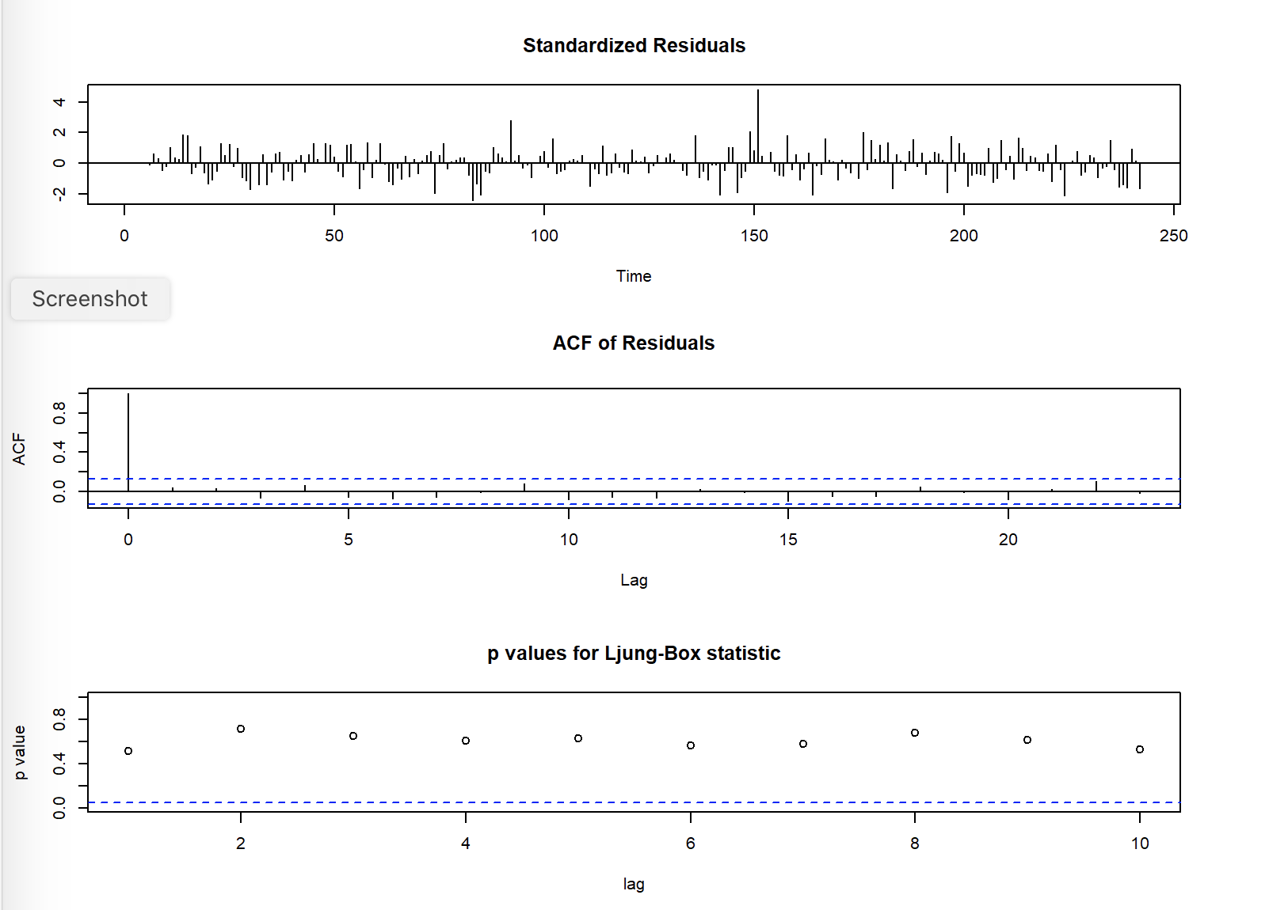
RESIDUAL PLOT OF MODEL 4
-> b3<-tsdiag(fit4)
All the p-values are greater than 0.05 so we are accepting the alternative hypothesis that there is no autocorrelation and all the predictable information has been captured by our model

Slide 18
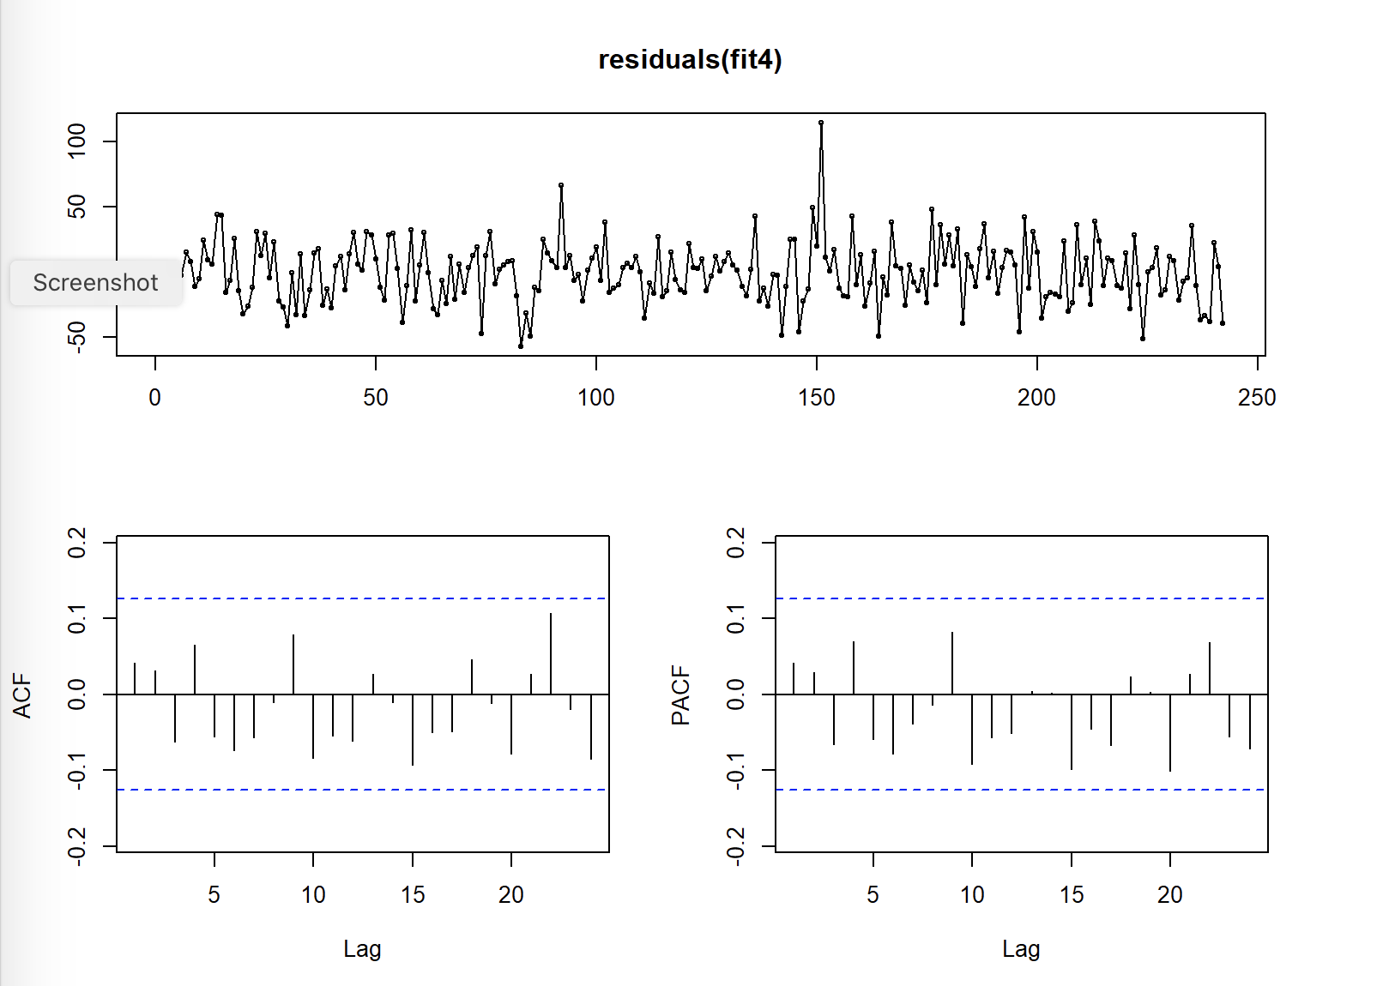
CORRELOGRAM OF RESIDUALS
-> tsdisplay(residuals(fit4))
All the lags are within the confidence interval and there is no autocorrelation

Slide 19
BOX LJUNG TEST
-> Box.test(residuals(fit4), lag=50, fitdf=5, type="Ljung")
OUTPUT
## Box-Ljung test ## ## data: residuals(fit4) ## X-squared = 49.063, df = 45, p-value = 0.3135
The box test confirms the absence of autocorrelation in the residual

Slide 20
SIMPLE EXPONENTIAL SMOOTHING
rel_ses <- ses(data$Close)
OUTPUT
summary(rel_ses)
## ## Forecast method: Simple exponential smoothing ## ## Model Information: ## Simple exponential smoothing ## ## Call: ## ses(y = data$Close) ## ## Smoothing parameters: ## alpha = 0.9999 ## ## Initial states: ## l = 1110.7358 ## ## sigma: 21.8494 ## ## AIC AICc BIC ## 2825.054 2825.155 2835.521 ## ## Error measures: ## ME RMSE MAE MPE MAPE MASE ACF1 ## Training set 1.643376 21.75889 16.41057 0.1122621 1.256123 0.9958725 0.01462906 ## ## Forecasts: ## Point Forecast Lo 80 Hi 80 Lo 95 Hi 95 ## 243 1508.393 1480.392 1536.394 1465.569 1551.217 ## 244 1508.393 1468.795 1547.991 1447.834 1568.952 ## 245 1508.393 1459.897 1556.889 1434.225 1582.561 ## 246 1508.393 1452.395 1564.391 1422.752 1594.034 ## 247 1508.393 1445.786 1571.000 1412.643 1604.143 ## 248 1508.393 1439.810 1576.976 1403.505 1613.281 ## 249 1508.393 1434.315 1582.471 1395.101 1621.685 ## 250 1508.393 1429.201 1587.585 1387.279 1629.507 ## 251 1508.393 1424.397 1592.389 1379.933 1636.853 ## 252 1508.393 1419.854 1596.932 1372.984 1643.802
)
Single Exponential Smoothing, SES for short, also called Simple Exponential Smoothing, is a time series forecasting method for univariate data without a trend or seasonality.
It requires a single parameter, called alpha , also called the smoothing factor or smoothing coefficient.

Slide 21
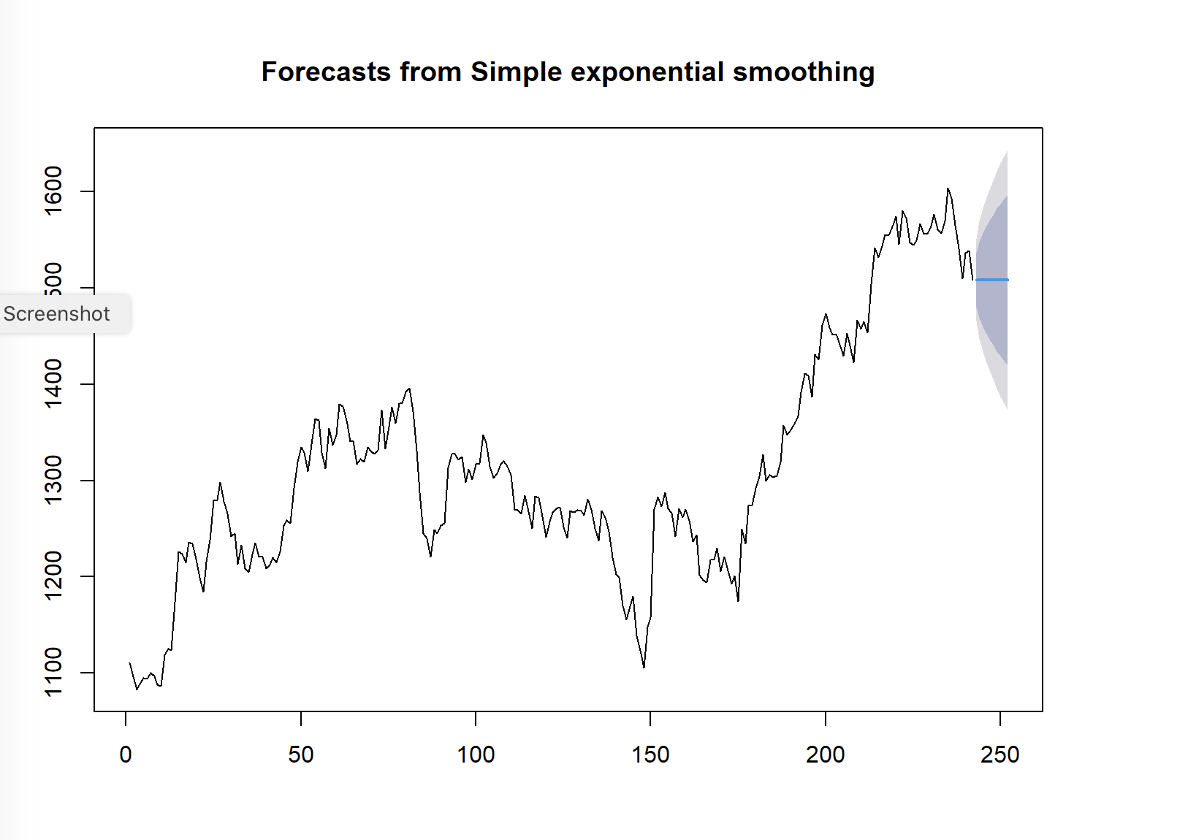
SES PLOT
-> plot(rel_ses)
Since ses does not takes trend and seasonality into account it fails to make accurate prediction of the data
as our data has both trend and seasonality

Slide 22
FIT HOLT EXPONENTIAL SMOOTHING MODEL
##Fit Holt exponential smoothing model rel_holt <- holt(data$Close) summary(rel_holt)
## ## Forecast method: Holt's method ## ## Model Information: ## Holt's method ## ## Call: ## holt(y = data$Close) ## ## Smoothing parameters: ## alpha = 0.9999 ## beta = 0.0001 ## ## Initial states: ## l = 1094.0772 ## b = 1.8409 ## ## sigma: 21.901 ## ## AIC AICc BIC ## 2828.170 2828.424 2845.615 ## ## Error measures: ## ME RMSE MAE MPE MAPE MASE ## Training set -0.1283302 21.7192 16.61311 -0.0229248 1.273852 1.008163 ## ACF1 ## Training set 0.01223065 ## ## Forecasts: ## Point Forecast Lo 80 Hi 80 Lo 95 Hi 95 ## 243 1510.231 1482.164 1538.298 1467.306 1553.156 ## 244 1512.069 1472.376 1551.762 1451.364 1572.774 ## 245 1513.907 1465.291 1562.522 1439.556 1588.258 ## 246 1515.744 1459.606 1571.883 1429.888 1601.601 ## 247 1517.582 1454.815 1580.350 1421.587 1613.577 ## 248 1519.420 1450.658 1588.182 1414.258 1624.582 ## 249 1521.258 1446.983 1595.533 1407.664 1634.851 ## 250 1523.096 1443.689 1602.503 1401.653 1644.538 ## 251 1524.934 1440.706 1609.161 1396.118 1653.749 ## 252 1526.771 1437.983 1615.560 1390.981 1662.561

Slide 23
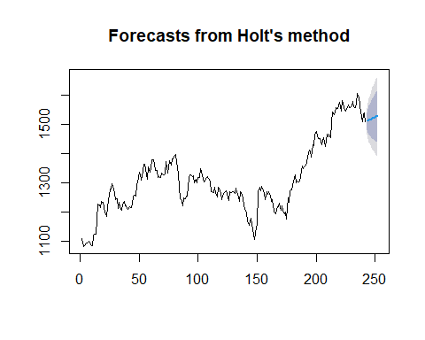
HOLT PLOT
#Plot the forecasted values plot(rel_holt)

Slide 24
FIT HOLT-WINTERS EXPONENTIAL SMOOTHING MODEL
##Fit Holt-Winters exponential smoothing model ##Converting the data as Time Series y <- ts(data.matrix(data$Close), start = as.Date("2019-01-01"), end = as.Date ("2019-12-31"), frequency=5) ##Fit with hw rel_hw <- hw(y, h = 10, seasonal = c("additive","multiplicative")) summary(rel_hw)
## ## Forecast method: Holt-Winters' additive method ## ## Model Information: ## Holt-Winters' additive method ## ## Call: ## hw(y = y, h = 10, seasonal = c("additive", "multiplicative")) ## ## Smoothing parameters: ## alpha = 0.9999 ## beta = 0.0027 ## gamma = 0.0001 ## ## Initial states: ## l = 1099.1873 ## b = 5.1102 ## s = -0.4502 0.0349 0.0638 0.3297 0.0218 ## ## sigma: 32.9733 ## ## AIC AICc BIC ## 26412.82 26412.94 26467.89 ## ## Error measures: ## ME RMSE MAE MPE MAPE MASE ## Training set -1.062704 32.89175 18.01642 -0.1138791 1.402574 0.3912539 ## ACF1 ## Training set 0.07561291
## Forecasts: ## Point Forecast Lo 80 Hi 80 Lo 95 Hi 95 ## 18261.20 1268.586 1226.329 1310.843 1203.959 1333.212 ## 18261.40 1268.235 1208.398 1328.073 1176.722 1359.749 ## 18261.60 1268.140 1194.757 1341.523 1155.911 1380.369 ## 18261.80 1267.570 1182.723 1352.418 1137.807 1397.334 ## 18262.00 1267.978 1172.989 1362.966 1122.705 1413.251 ## 18262.20 1268.214 1164.018 1372.409 1108.860 1427.567 ## 18262.40 1267.863 1155.169 1380.557 1095.513 1440.213 ## 18262.60 1267.768 1147.133 1388.403 1083.273 1452.263 ## 18262.80 1267.198 1139.076 1395.321 1071.252 1463.145 ## 18263.00 1267.605 1132.373 1402.838 1060.785 1474.426

Slide 25
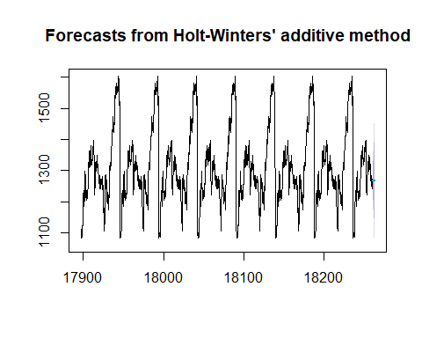
HOLT-WINTERS’ PLOT
#Plot the forecasted values plot(rel_hw)

Slide 26
FIT WITH HOLT WINTERS
##Fit with HoltWinters rel_hw <- HoltWinters(y, seasonal = "mult") rel_hw
## Holt-Winters exponential smoothing with trend and multiplicative seasonal component. ## ## Call: ## HoltWinters(x = y, seasonal = "mult") ## ## Smoothing parameters: ## alpha: 0.9942005 ## beta : 0 ## gamma: 1 ## ## Coefficients: ## [,1] ## a 1269.8513733 ## b 0.2337714 ## s1 1.0003338 ## s2 0.9995587 ## s3 0.9991900 ## s4 0.9974088 ## s5 0.9988177
pred <- predict(rel_hw, 50, prediction.interval = TRUE) plot(rel_hw, pred)

Slide 27
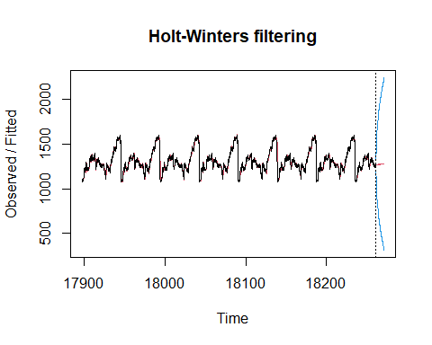

Slide 28
AUTOMATED EXPONENTIAL SMOOTHING MODEL
#Fit automated exponential smoothing model rel_auto <- forecast(data$Close, h = 10) summary(rel_auto)
## ## Forecast method: ETS(A,N,N) ## ## Model Information: ## ETS(A,N,N) ## ## Call: ## ets(y = object, lambda = lambda, biasadj = biasadj, allow.multiplicative.trend = allow.multiplicative.trend) ## ## Smoothing parameters: ## alpha = 0.9999 ## ## Initial states: ## l = 1110.7358 ## ## sigma: 21.8494 ## ## AIC AICc BIC ## 2825.054 2825.155 2835.521 ## ## Error measures: ## ME RMSE MAE MPE MAPE MASE ACF1 ## Training set 1.643376 21.75889 16.41057 0.1122621 1.256123 0.9958725 0.01462906 ## ## Forecasts: ## Point Forecast Lo 80 Hi 80 Lo 95 Hi 95 ## 243 1508.393 1480.392 1536.394 1465.569 1551.217 ## 244 1508.393 1468.795 1547.991 1447.834 1568.952 ## 245 1508.393 1459.897 1556.889 1434.225 1582.561 ## 246 1508.393 1452.395 1564.391 1422.752 1594.034 ## 247 1508.393 1445.786 1571.000 1412.643 1604.143 ## 248 1508.393 1439.810 1576.976 1403.505 1613.281 ## 249 1508.393 1434.315 1582.471 1395.101 1621.685 ## 250 1508.393 1429.201 1587.585 1387.279 1629.507 ## 251 1508.393 1424.397 1592.389 1379.933 1636.853 ## 252 1508.393 1419.854 1596.932 1372.984 1643.802
#Plot the forecasted values plot(forecast(rel_auto))

Slide 29
